Slide 1
Valve Area calculation
&
Shunt Detection And Quantification
Dr Shajudeen
2nd year DM Resident

Slide 2
Calculation of stenotic valve area
GORLIN FORMULA:
A = F
VC_{C}
Torricelli's law:
Flow across a round orifice F = AV C_{C}
F = Flow rate A = Orifice area
V = Velocity of flow C_{C} = Coefficient of orifice contraction
2. Pressure gradient and velocity of flow Relation - Torricelli's law
V = velocity of flow
C_{v} = coefficient of velocity - correcting for energy loss as pressure energy is converted to
kinetic or velocity energy
h = pressure gradient in cm H₂O
g = gravitational constant (980 cm/sec²) for converting cm H₂O to units of pressure

Slide 3
GORLIN FORMULA:
C = empirical constant accounting for C_{V} and C_{C}
h = mm Hg
C - empirical constant ( 0.85 for mitral valve, 1.0 for Aortic valve)

Slide 4
Flow (F) = Total cardiac output expressed in terms of the seconds per minute during which there is actually forward flow across the valve.
F= CO (ml or cm³/min)
SEP/DFP (sec/min) x HR
cm³ x min
Min x Sec
cm³ /sec

Slide 5
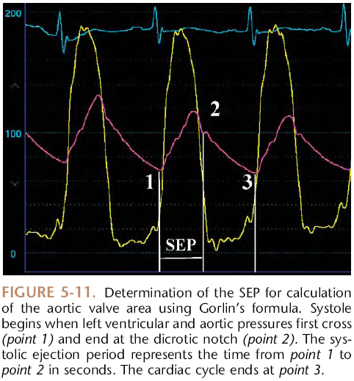
Systolic ejection period calculation

Slide 6
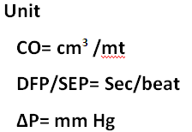
AREA CALCULATION FOR MITRAL VALVE & AORTIC VALVE

Slide 7
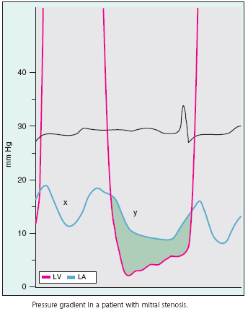
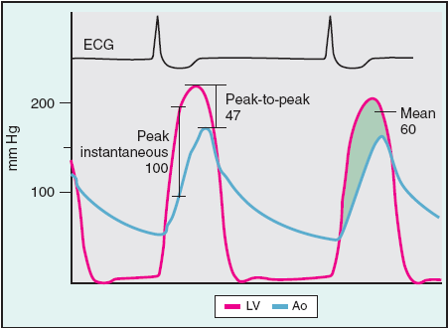
Transvalvular gradient some definitions
Peak-to-Peak gradient :
Difference between the peak left ventricular and aortic systolic
pressure.
No physiologic relevance for this because these peaks occur at
different times.
Peak instantaneous gradient : Represents the largest gradient that exists between the left ventricle and the aorta.
Mean Gradient: Average of each instantaneous gradient that exists
during systole.

Slide 8
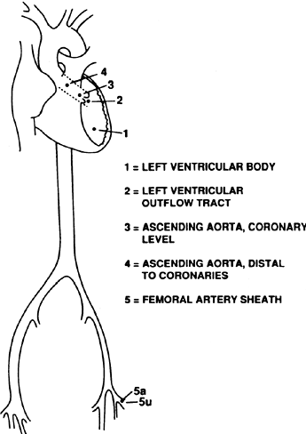
Gradient calculation LV-AO
For accurate LV –AO gradient calculation by cath
Preffered catheter position for LV-Ao gradient calculation is LV body & Ascending aorta Rather than LV & FA
Use Simultaneously taken tracing from AO and LV
Use Two catheter or Dual Lumen catheter
(Langston Catheter)

Slide 9
LV-Femoral Artery Pressure Tracings and its realignment
Time Delay Between LV and FA tracing. (LV-Gradient overestimated by 9 mm Hg)
After realignment ( LV- Ao Gradient underestimated by 10 mm Hg)

Slide 10
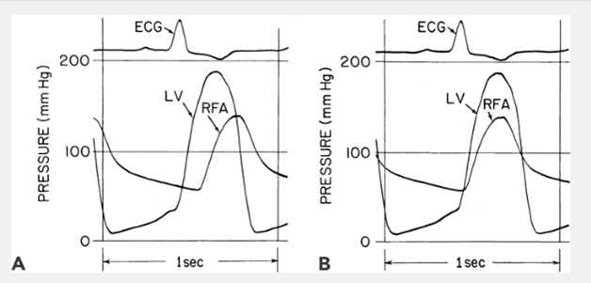
Errors in gradient measurement
1) Systolic amplification and widening of
pressure waveform
LV-AO Gradient overestimated by 9 mm Hg
LV- AO Gradient underestimated by 10mm Hg

Slide 11
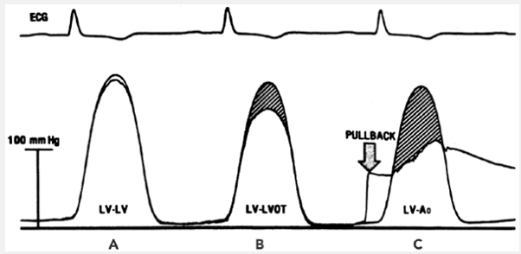
Errors in gradient measurement
2) LV Catheter placed in LVOT
Substantial pressure gradient between the body of the LV & LVOT . This is due to acceleration of blood as it enters the relatively narrow outflow tract

Slide 12
VALVE AREA CALCULATION CHART

Slide 13
Alternative formula to Gorlin: Hakki formula
Assumption: Heart rate x SEP or DFP x Constant ≈1
When compared to the traditional Gorlin formula the above formula may lead to significant disparity if tachycardia is present (heart rate >100 beats/min).

Slide 14
Shunt Detection and Quantification

Slide 15
Introduction
Detection of LEFT to RIGHT SHUNT
Oximetry run
PBF calcualtion
SBF calculation
Left to right shunt Detection & Quantification
Flow Ratio (Q_{P}/Q_{S})
Limitation of oximetry method
Other methods of left to right shunt
Detection of RIGHT to LEFT SHUNT
Bidirectional Shunt

Slide 16
SHUNT DETECTION AND QUANTIFICATION
SHUNT :
Detect
Localisation
Quantification
POINTERS TO SUSPECT INTRA CARDIAC SHUNT
Unexplained Systemic arterial desaturation
PA Saturation Unexpectedly High

Slide 17
INTRODUCTION
O2 CONTENT
Total amount of oxygen present in a blood
(O2 bound to Hb + Plasma Dissolved O2)
Calcuted directly or derived
O2 SATURATION
O2 bound to Hb
O2 CARRYING CAPACITY OF Hb = 1.36 ML O2 PER GRAM OF HB
DISSOLVED O2 = 0.03 x Partial Pressure of O2 in mm Hg
RELATION BETWEEN O2 SATURATION AND CONTENT
O2 content =O2 carrying capacity of Hb x % Saturation +
Dissolved O2

Slide 20
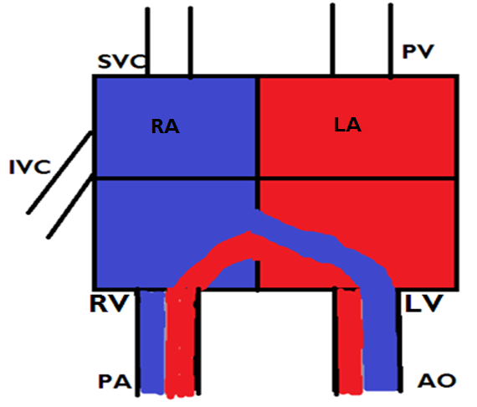

Slide 21
Left to Right shunt:
Oxygenated blood that bypasses the systemic
vascular bed
Right to left shunt:
Deoxygenated blood that bypasses the pulmonary
vascular bed
Admixture lesion:
Anatomical defects facilitates the mixing of
oxygenated & deoxygenated blood
Transposition physiology:
Anatomic abnormality preventing oxygenated blood
reaching the systemic vascular bed

Slide 22
Detection Of Left To Right Shunt
L – RT SHUNT : Detection need “Significant O2 step up” in blood oxygen saturation or content in one of the right heart chamber/PA
Significant Step up : Increase in blood O2 content or saturation that exceeds the normal variability that might be observed if multiple samples were drawn from that cardiac chamber

Slide 23
Screening for Left To Right Shunt
Take blood samples from SVC and PA if Δ O 2 saturation between these is ≥8% ,It means Left to right shunt is there so do complete Oximetry run to locate and to quantify the shunt

Slide 24
Catheter for Oximetry run
End hole Catheter (Swan Ganz balloon flotation catheter) or one with side hole near close to its tip
Catheter tip position adjusted by pressure measurement
2 ml blood should be taken from each site

Slide 25
OXYMETRY RUN: Sample Collection sites
Left and/or Right PA
MPA
RVOT
Mid RV
RV near TV or Apex
RA (low or near TV).
Mid RA.
High RA
Low SVC (Near junction with RA
High SVC (Near junction with
innominate vein)
IVC high (just at or below
diaphragm)
IVC low (at L4- L5)
LV
Aorta (distal to insertion of ductus)
.

Slide 26
GUIDELINES FOR OPTIMUM USE OF OXIMETRIC METHOD FOR SHUNT DETECTION AND QUANTIFICATION
Blood samples at multiple sites should be obtained rapidly.
Blood O₂ saturation data rather than O₂ content data are preferable
Comparison of the mean of all values obtained in the respective chambers is preferable to comparison of highest values in each chamber.
Because of the important influence of SBF on shunt detection exercise should be used in equivocal cases where a low SBF is present at rest.

Slide 27
GUIDELINES FOR OPTIMUM USE OF OXIMETRIC METHOD FOR SHUNT DETECTION AND QUANTIFICATION conti . .
The sampling to be done with the patient breathing room air or a gas mixture containing no more than a maximum of 30% oxygen
Saturation data may be inaccurate in patients breathing more than 30% oxygen, as a significant amount of oxygen may be present in dissolved form in the pulmonary venous sample.

Slide 28
Normal values for O₂ saturation

Slide 30
Detection of Left to Right Shunt by Oximetry
Criteria for Significant Step up
 | Difference in Mean between Distal and Proximal chamber samples |  | Difference in Highest value between Proximal and Distal chamber |  | Approximate Minimal Q_{p}/Q_{s} required to Detection ( Assuming SBFI=3L/min/M²
 | O₂ % sat | O₂ vol % | O₂ % sat | O₂ vol%
Atrial (SVC/IVC to RA | ≥ 7 | ≥ 1.3 | ≥11 | ≥ 2 | 1.5-1.9
Ventricular (RA to RV) | ≥ 5 | ≥ 1 | ≥ 10 | ≥1.7 | 1.3-1.5
Great vessel (RV to PA) | ≥ 5 | ≥ 1 | ≥ 5 | ≥ 1 | ≥ 1.3
Any level | ≥ 7 | ≥ 1.3 | ≥ 8 | ≥1.5 | ≥ 1.5

Slide 31
Causes of O₂ Step up at various level
Atrial :
ASD
PAPVC
RSOV to RA
VSD with TR
Coronary fistula to RA
Ventricular
VSD
PDA with PR
Ostium Primum ASD
Coronary fistula to RV

Slide 32
Great vessels
PDA
AP window
Abberant coronary artery origin

Slide 33
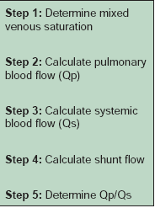
What to do if significant step up detected?
Calculate
PBF
SBF
Magnitude shunt

Slide 34
MVO2 Calculation
The mixed venous oxygen content is the average oxygen content of the blood in the chamber proximal to the left to right shunt
MVO2 ( At Rest) = 3 SVC O2 + 1 IVC O2
4
MVO2 ( At Exercise) = 1 SVC O2 + 2 IVC O2
3

Slide 35
Calculation of Pulmonary Blood flow (Q_{P} )
PV O₂ = Pulmonary venous O₂ concentration
PA O₂ = Pulmonary artery O₂ concentration
VALUES
PULMONARY VEIN = 95% If systemic saturation ≥95%
If systemic saturation <95% check whether intra cardiac
shunt present or not. If not there take value as 98% if
there take the arterial saturation as pulmonary vein
saturation

Slide 36
CALCULATION OF SYSTEMIC BLOOD FLOW (Q_{S} )
SA O2 = Systemic Arterial O2 content
MV O2 = Mixed Venous O2 content

Slide 37
Magnitude of shunt
Expressed in terms of either Absolute blood flow across
the shunt in L/mt or as a ratio of the PBF to SBF.
Left to right shunt = Q _{p} – Q _{S} or Q_{P}/Q_{S}

Slide 38
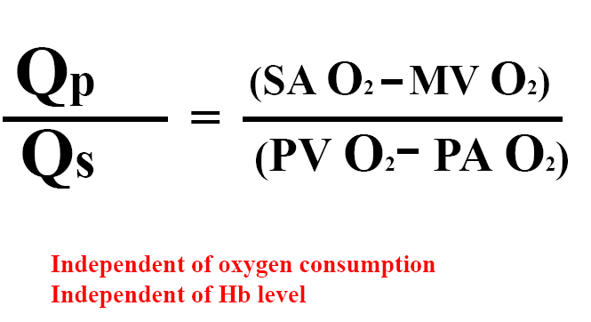
Flow ratio
Use O2 % saturation
Q_{P}/Q_{S} Ratio
< 1 means Right to Left shunt
< 1.5 but >1 means Small left to right shunt
≥2 Large left to Right shunt

Slide 39
Limitation of oximetry method
Absence of steady state during the collection of blood sample
Lacks sensitivity
Elevated SBF will cause mixed venous oxygen saturation to be higher than normal and inter chamber variability will be blunted.

Slide 40
If oxygen content is used for calculating the shunt rather than O2 saturation Hb concentration will effect the result
Small shunts or in the presence of high cardiac output (which decreases AVO2 difference) oximetry data loses its accuracy

Slide 41
The magnitude of the step-up varies with the oxygen-carrying capacity of blood and the cardiac output.
The relationship between the magnitude of step-up and the shunt flow is nonlinear and with increasing left-to-right shunting, a given change in shunt flow produces less of a change in the saturation step-up.

Slide 42
Other method of shunt detection
Indocyanine green curve
Radionuclide technique
Contrast angiography
Echocardiography

Slide 43
Indocyanine green curve
It can detect shunts too small to be detected by the oxygen step-up method
IF negative , no need to perform an complete oximetry run.

Slide 44
Procedure
Dye injection: Proximal chamber and a sample is taken from a distal
chamber.
Using a densitometer, the density of dye is displayed over time distal chamber
L- RT shunt : Injected to PA sampling done at BA
Finding: Early recirculation on the downslope of the dye
curve
Rt - Lt shunt :
Injected into the right side of the heart proximal to the
location of the suspected shunt and blood samples
obtained from a BA
Findings: Distinct, early peak present on the upslope of the
curve

Slide 45
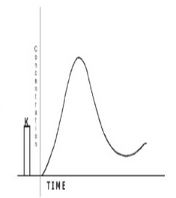
Indocyanine green curve
Normal
LEFT TO RIGHT SHUNT
Limitation of Indocyanine green curve
It cannot locate the site of shunt

Slide 46
Right to left shunt

Slide 47
Angiography
Selective angiography done for visualizing and locating the site of left to right shunt
View
LAO Cranial View: IV Septum, Sinus of Valsalva , AT Aorta , DT Aorta

Slide 48
Detection Of Right To Left Shunt
R-L shunt suspected if cyanosis or arterial desaturation is there (<93%)
If hypoxemia present aim is to find out the location and magnitude of the shunt

Slide 49
Oximetry :
Take Oximetry sampling from PV, LA, LV and Aorta
First chamber which shows desaturation is the site of shunt
Disadvantage: In adults PV & LA entry difficult

Slide 50
Other Methods to detect R to L shunt
Contrast echocardiography
Echo doppler technique

Slide 51
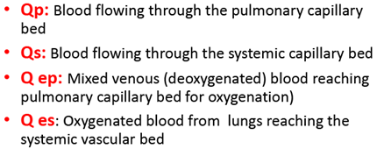
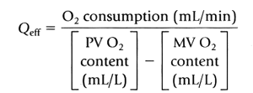
Bidirectional flow
Effective Blood Flow (EBF) is the fraction of mixed venous return received by the lungs without contamination by the shunt flow or the oxygenated blood reaching the systemic circulation without the shunt blood
Left to Right shunt = Q_{P} – Q _{eff}
Right to left shunt = Q_{S} − Q _{eff}

Slide 53
THANK U

Slide 54
MCQ 1
1) Normal SVC TO RA & RA to PA O₂ saturation difference
a) 3.9% ± 2.4%. & 2.3% ± 1.7%
b) 6.7% ± 3.3% & 5.25% ± 2.8%
c) 6% ± 1.5% & 3% ± 2.8%
d) 2.8% ± 1.2% & 2% ±1.8%

Slide 55
2) To say Significant step in O2 saturation difference between Mean of distal chamber and proximal chamber samples in SVC/IVC to RA, RA to RV, RV to PA are
a) ≥8, ≥4, ≥3
b) ≥7, ≥5, ≥5.
c) ≥9, ≥8, ≥4.
d) ≥1.3, ≥1, ≥1.

Slide 56
Equation for calculating MVO2 at exercise
a)MVO2 = 3 SVC O2 + 1 IVC O2
4
b) MVO2 = 1 SVC O2 + 2 IVC O2
3
c) MVO2 = 2 SVC O2 + 3 IVC O2
4
d) MVO2 = 1 SVC O2 + 2 IVC O2
3

Slide 57
4) In Gorlins equation for calculation for MVA
calculation what is the value for the constant C
0.65
0.85
0.95
8.5

Slide 58
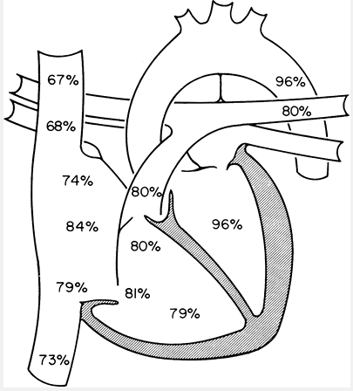
5) Identify and quantify the lesion
Small to moderate ASD

Slide 59
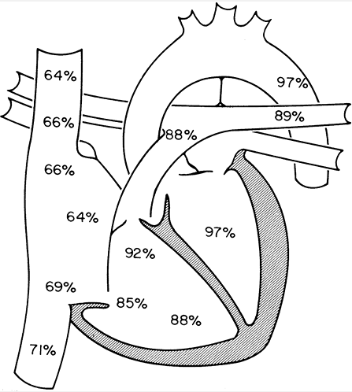
6) Identify and quantify the lesion
LARGE VSD

Slide 60
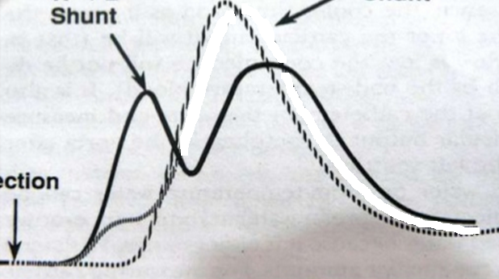
7) Indocyanine green curve indicates what?
Normal
???????????

